Slide 1

Digital Image Processing
31-Image restoration vs Image enhancement
Image restoration:
(large mask – objective – recover image that has been degraded تدهورت )
Image enhancement:
(small mask – subjective – improve image)

Slide 2
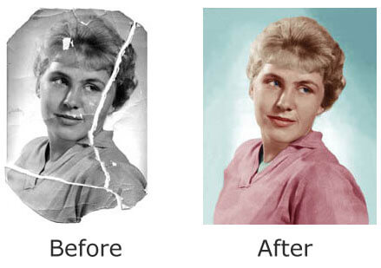
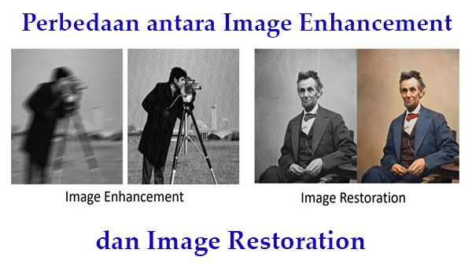
Digital Image Processing
Image restoration vs Image enhancement

